Slide 1
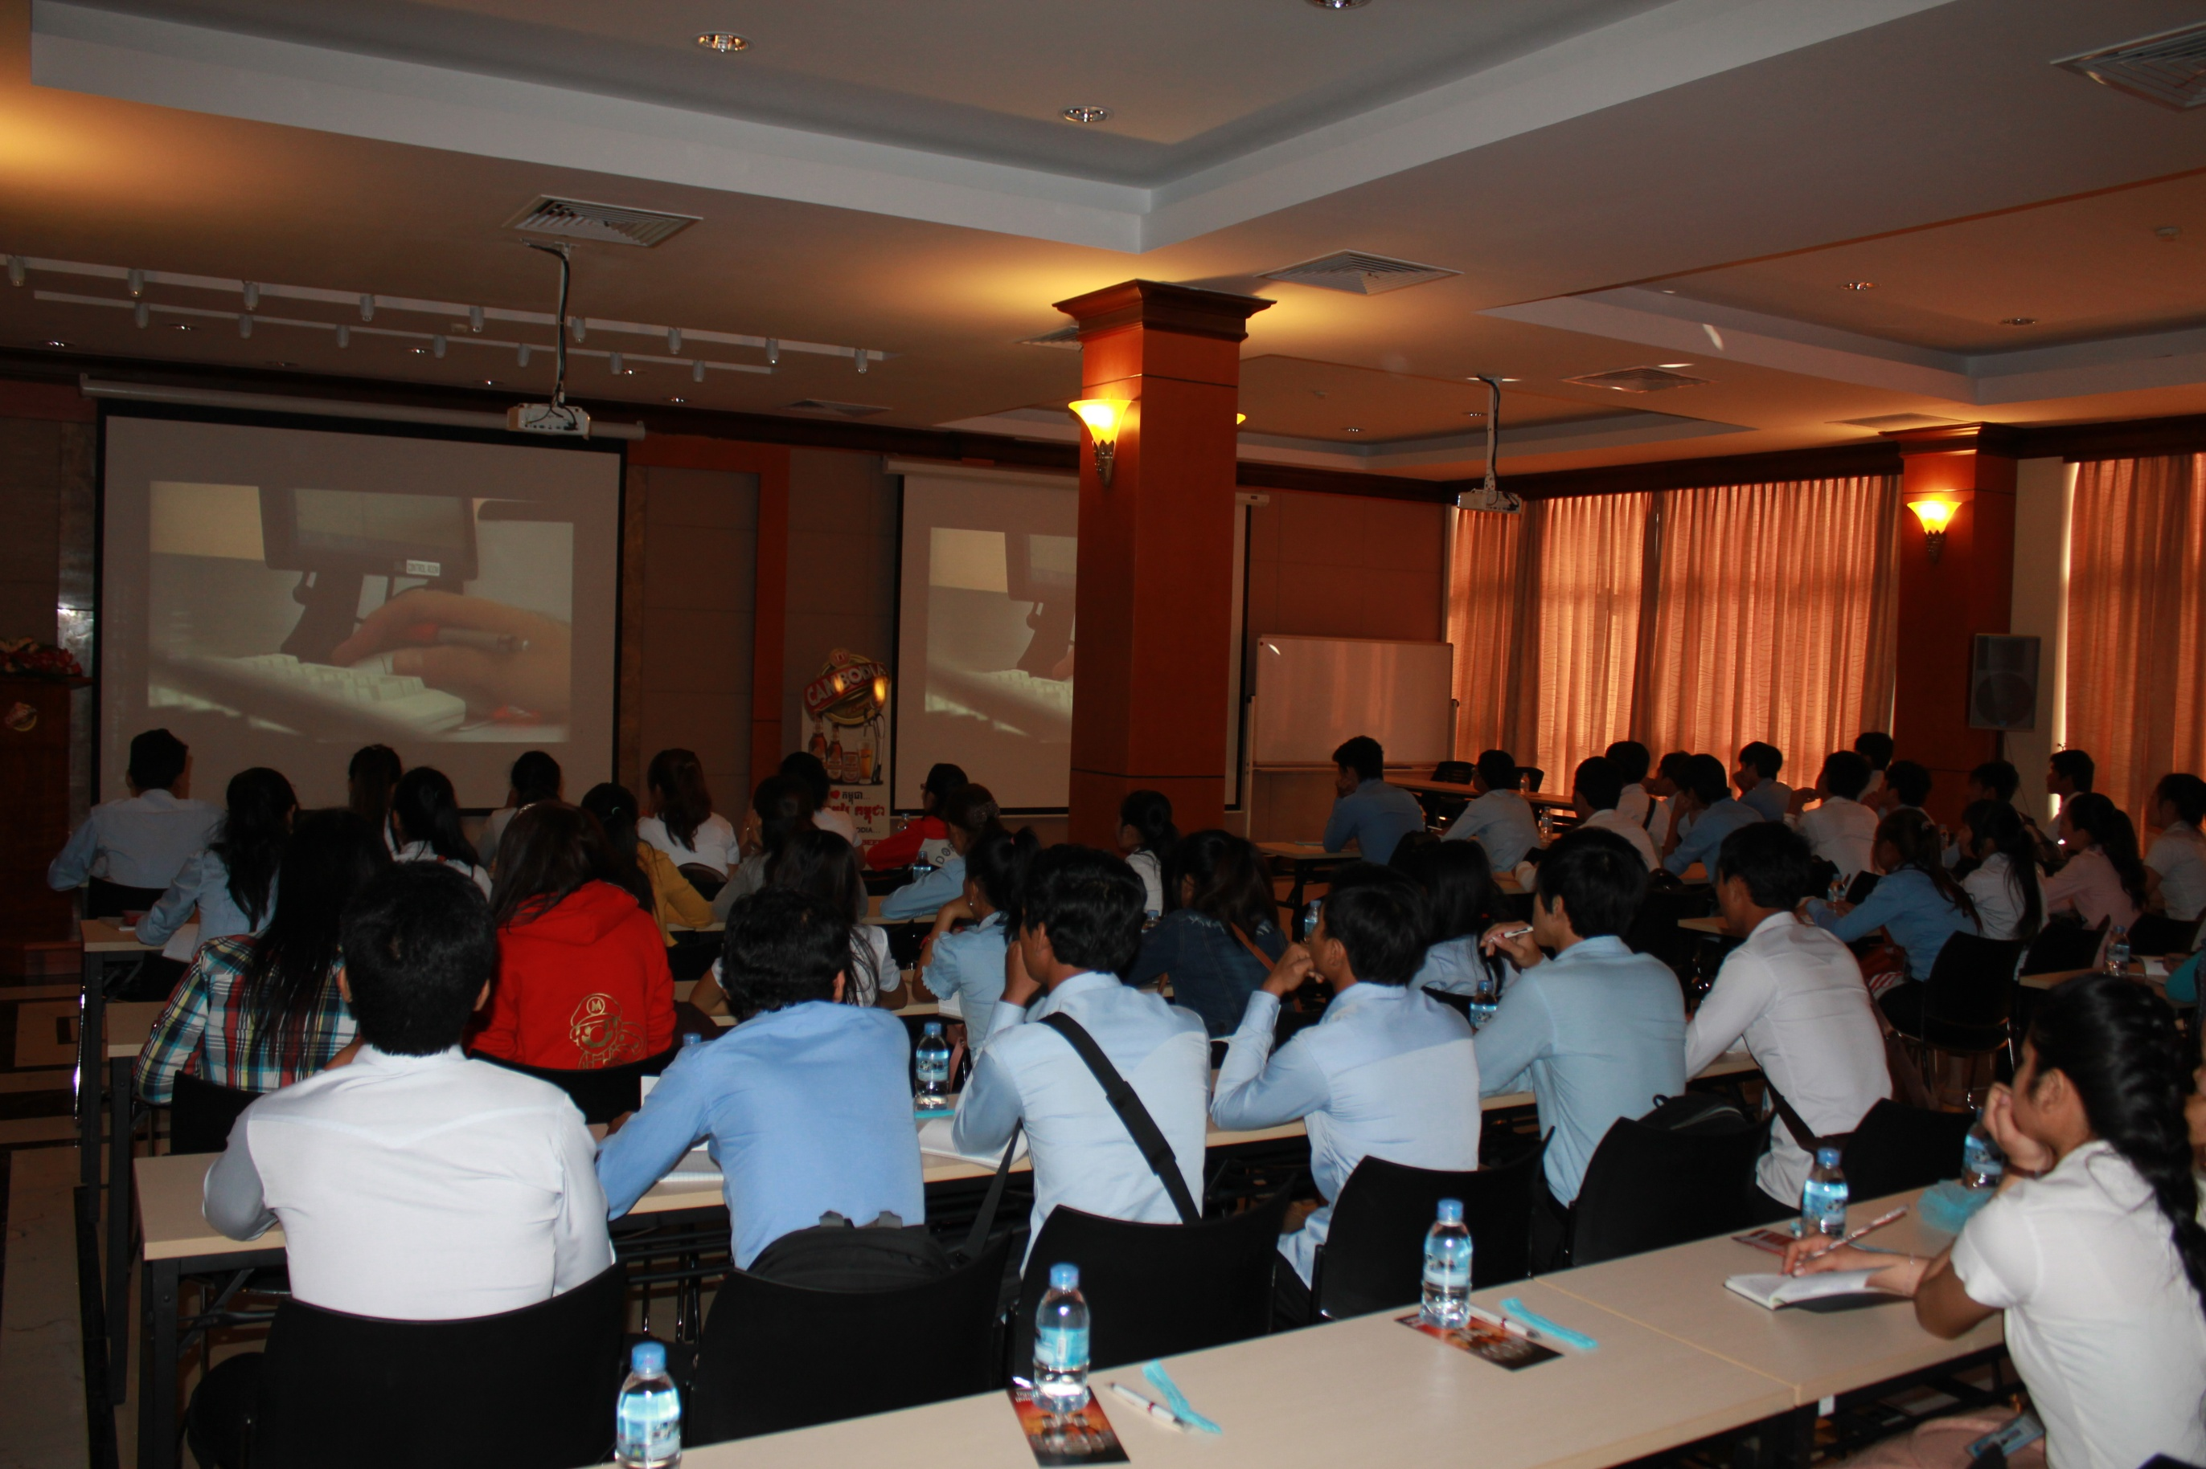

Starting Guide for
Research Proposal
IIC University of Technology
The Kingdom of Cambodia

Slide 2
What is Research Proposal
A research proposal is your plan
  It describes in detail your study
  Decisions about your study are based on the quality of the proposal
    Research funding
    Approvals to proceed by the Institutional Review Board

Slide 3
Overview of Research Proposal
Theoretical
Framework
Need
Literature
Plan
Method
Evaluate

Slide 4
Budget Your Time
Solid partnerships
Communicate
Innovative project
Define your budget
80% planning the project 20% writing the proposal
Notes:
Have your ducks in a row BEFORE you write a proposal – have your partnerships and budget as close to final as possible…and remember that Innovative projects will catch their attention

Slide 5
Avoid Plagiarism
Avoid Plagiarism
Plagiarism is presenting someone else’s ideas or words as though they were your own.
DANGEROUS!!!!

Slide 6
Research Proposal Elements
Research Proposal Elements
Background/ significance
Research Question/Aim/Purpose
Methods
  Design
  Sample/Sample Size
  Setting
  Protocol
  Analysis plan
Timeline

Slide 7
Chapter One : Introduction
1.1 Background of the study
  To describe the current business /industry environment.
1.2 Problem Statement
  From the background, identify all the possible problems.
1.3 Needs of study
  From the problems, identify one of the most significant problem needs solution urgently.
1.4 Objective / Purpose of the Study
  From the needs of study, objective of research is formed to help you to solve the problem.

Slide 8
Chapter One : Introduction
1.5 Research Questions
  From the objectives, state all curiosities that derive from the objectives.
1.6 Hypothesis
  Based on literature, create assumption for the study.
1.7 Definition of Terms
  Provide meaning of terms used in the research based the research construct.
1.8 Significance of Study
  Identify parties that would get benefit of this research.

Slide 9
Chapter Two: Literature Review
Provide practitioners to understand in-depth of the issues and all possible methods for problem solving.
At the end of the chapter, a theoretical framework is proposed to solve the problems.

Slide 10
Chapter Two: Literature Review
2.1 Background of the research
  Provide details to explain and support what was discussed in 1.1 (Background); 1.2 (Problem statement) and 1.3 (needs of study).
2.2 Historical Background
  Researcher needs to provide details development of the field of study. All methods of problem solving are discussed here.

Slide 11
Chapter Two: Literature Review
Theoretical Background
  Build up a model to solve the problems.
Related Research
  Other research that might discuss the issues and any problem solving methods.

Slide 12
Chapter Three: Research Methodology
Researcher needs to identify how they run the research.
The questions to be answered:
  Who to test?
  Where to test?
  How to test?
  When to test?
  What to test ?

Slide 13
Chapter Four: Results
  Observation and what they have encountered (Successful and Not Successful) when running the method propose to solve the problem.
  Barrier/problems when running the method proposed.
  What to do to improve the method during the process.
  Final model that could be proposed after all the challenges.

Slide 14
Chapter Five:Results & Recommendation
Researcher needs to
  conclude the proposed method.
  Identify the implication for other practitioners.
  suggest for other researcher how to improve it.
  Identify the limitation in the research

Slide 15
Data Analysis
Data Analysis
Describe your analysis plan
  What statistical tests will you use?
  Be sure your statistics are appropriate for your study design

Slide 16
Timeline
Describe how long it will take to do your study
Provide timeline benchmarks
Use a Gantt Chart to summarise your timeline

Slide 17
Common pitfalls to avoid
Common Pitfall to Avoid
Missing aims or purpose
Not enough detail about protocol
  Write your proposal so anyone reading it can understand your plan
Is your study significant?
  Does it answer the larger “So what” question? Why should researchers care about this work?
Underpowered sample size
  Describe why you are using the sample size and justify it
Invalid or unreliable instrumentation
  Has your instrument been tested with the population you are studying? If not, will you test it within your study?
Improper statistics
  Are you using the appropriate statistical analysis?

Slide 18
Evaluation of proposals
Evaluation of Proposal
Proposals reviewed based on specific criteria defined by the IIC Graduate School
  The research design must be sound enough to yield the expected knowledge
  The aims/objectives are likely to be achievable in the given time period
  The rationale for the proposed number of participants is reasonable
  The scientific design is described and adequately justified

Slide 19
Factor to Consider
1
PRACTICAL
CONSIDERATIONS
2
HUMAN
CONSIDERATIONS
3
COMPREHENSION
4
QUALITY
5
COMPETITIVE EDGE

Slide 20

Wishing you all the best!

